Slide 1
Web Technologies
XML ,DTD, Schema

Slide 2
XML
XML stands for eXtensible Markup Language
XML was designed to store and transport data
Set of rules for encoding documents in a format that is both human-readable and machine readable.
XML tags are created by user and are not predefined by the language

Slide 3
XML Document Model
A document model is used to enforce structure within a document
Two types of document models for XML:
DTD – Document Type Definition
XML Schema
Document models are not required in XML
If a document conforms to a document model it is valid

Slide 4

Comparisons
XML
HTML
Extensible set of tags
Content orientated
Standard Data infrastructure
Allows multiple output forms
Tags are case sensitive
Fixed set of tags
Presentation oriented
No data validation capabilities
Single presentation
Tags are not case sensitive

Slide 5
Components of XML
Elements
Attributes
Entities

Slide 6
Writing XML Documents
An XML element is made up of a start tag, an end tag, and data in between.
Example:
<director> Matthew Dunn </director>
Example of another element with the same value:
<actor> Matthew Dunn </actor>
XML tags are case-sensitive:
<CITY> <City> <city>

Slide 7
Sample XML
Declaration
<?xml version=”1.0” encoding = "UTF-8" standalone = "yes"?>
<books>
<book isbn=“123”>
<title> Second Chance </title>
<author> Matthew Dunn </author>
</book>
</books>
Attribute
Element

Slide 8
Guidelines for Authoring XML
All elements must have an end tag.
All elements must be cleanly nested (overlapping elements are not allowed).
All attribute values must be enclosed in quotation marks.
Each document must have a unique first element, the root node.

Slide 9
Checking conformance
Well Formedness
Validation

Slide 10
Well formedness
A well-formed XML document must have a corresponding end tag for all of its start tags.
Nesting of elements within each other in an XML document must be proper.
In each element two attributes must not have the same value
An XML document can contain only one root element.
amp(&), apos(single quote), gt(>), lt(<), quot(double quote) entities other than these must be declared

Slide 11
Validation
Validation is checking for the conformance by comparing with the document model

Slide 12
XML Document Model
A document model is used to enforce structure within a document
Two types of document models for XML:
DTD – Document Type Definition
XML Schema
If a document conforms to a document model it is valid

Slide 13
Document Type Definition (DTD)
XML elements and attributes are defined in a DTD
Two types of DTD’s:
Internal – DTD exists as part of the document
External – DTD is an external file

Slide 14
DTD Element Declaration
Syntax:
<!ELEMENT elementname (content)>
Element Content Types
Content of elements declaration in a DTD can be categorized as below −
Empty content
#PCDATA – text only
Element content
Sequences (sequence of elements)
Choices (a | b | c)
Mixed content
Any content

Slide 15
Empty Elements
<!ELEMENT BR EMPTY>
<!ELEMENT IMG EMPTY>
<!ELEMENT HR EMPTY>

Slide 16
#PCDATA
Parsed Character Data; i.e. raw text, no markup. For example,
<!ELEMENT year (#PCDATA)>
<year>1984</year>
(already seen this with hello.dtd !!)

Slide 17
Sequences
<name> <first_name>David</first_name> <last_name>Stratton</last_name> </name>
Separate multiple required child elements with commas; e.g.
<!ELEMENT name (first_name, last_name)>
15:56:50

Slide 18
Choices
A choice indicates one element or another but not both
A choice is signified by a vertical bar |
There can be two or more elements in a choice
<!ELEMENT date (year | ISODate)>
<!ELEMENT year (#PCDATA)>
<!ELEMENT ISODate (#PCDATA)>
16:01:23

Slide 19
Mixed Content
<!ELEMENT description (#PCDATA | ul | cite)*>
<!ELEMENT cite (#PCDATA)>
<!ELEMENT ul (li)*>
<!ELEMENT li (#PCDATA)>
Mixed content is both #PCDATA and child elements in a choice, followed by an asterisk
Should be avoided where possible
This is the only way to combine PCDATA with child elements in a content model
#PCDATA must come first
#PCDATA cannot be used in a sequence

Slide 20
ANY
<!ELEMENT catalog ANY>
A catalog can contain any child element and/or raw text (parsed character data)

Slide 21
DTD (cont’d)
Occurrence Indicator:
Indicator | Occurrence
(no indicator) | Required | One and only one
? | Optional | None or one
* | Optional, repeatable | None, one, or more
+ | Required, repeatable | One or more

Slide 22
DTD Attribute declaration
<!ATTLIST element-name attribute-name attribute-type attribute-value>
You can specify if an attribute −
can have a default value
can have a fixed value
is required
is implied

Slide 23
DTD Attribute Declaration
<!ATTLIST element-name attribute-name attribute-type "default-value">
<!ATTLIST element-name attribute-name attribute-type #FIXED "value" >
<!ATTLIST element-name attribute-name attribute-type #REQUIRED>
<!ATTLIST element-name attribute-name attribute-type #IMPLIED>

Slide 24
Internal DTD
<?xml version = "1.0"?>
<!DOCTYPE address
[
<!ELEMENT address ( name )>
<!ELEMENT name ( #PCDATA )>
<!ATTLIST name id CDATA #REQUIRED>
]>
<address> <name id = "123">Tanmay Patil</name> </address>

Slide 25
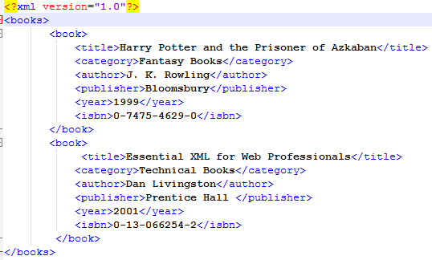
Book.xml
Root Element

Slide 26
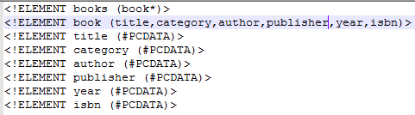
External DTD (book.dtd)

Slide 27
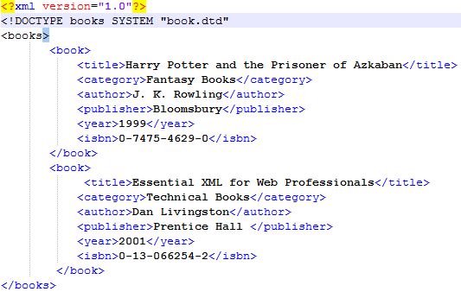
Attaching external DTD to xml document

Slide 28
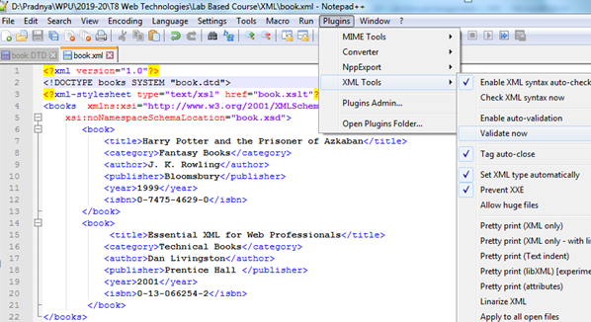
Validating xml (Notepad++)

Slide 29
Problems with DTDs
DTDs don’t use XML syntax
No support for document structure evolution, extension, or inheritance of declarations
difficult to write, maintain, and read large DTDs, and to define families of related document types
No constraints on character data (if character data is allowed, any character data is allowed)
11:57:32

Slide 30
XML Schema
Our second document model
Designed to replace DTD
Addresses weaknesses of DTDs
XML Schema specification released by the W3C in May 2001
XML Schemas normally kept in a file separate from the XML File
Given a .xsd suffix
XML schema language itself is a XML schema located at http://www.w3.org/2001/XMLSchema

Slide 31
XSD Features
XML Schema specification released by the W3C in May 2001
Developed as an alternative to DTD’s and is much more powerful
Features:
Pattern matching
Rich set of data types
Attribute grouping
Supports XML namespaces
Follows XML syntax

Slide 32
XML Schemas
The XML Schema specification consists of two parts:
XML Schema: Structures.
This specification consists of a definition language for describing and constraining the content of XML documents
XML Schema: Datatypes.
This specification defines the datatypes to be used in XML schemas.

Slide 33
Beginning XML Schemas
<?xml version=“1.0”>
<xsd:schema
xmlns:xsd=http://www.w3.org/2001/XMLSchema
(schema rules added here)
</xsd:schema>
Note: conforms to XML standards

Slide 34
XML Namespaces
XML developers are allowed to create XML documents containing elements (tags) whose names are not predefined (unlike HTML)
element names are likely not to be unique
Causes a naming conflict
A namespace is a means to uniquely identify the components of XML documents
In other words a namespace is a context within which the tag names are guaranteed to be unique
The Namespace is identified by URI(Uniform Resource Identifiers).
Notes:
The namespace in effect defines a context within which tag names are guaranteed to be unique. This is rather like the name of a directory on your hard disk – once you have specified the directory you have guaranteed the context in which file names will be resolved.

Slide 35
Namespace Example
<?xml version = "1.0" encoding = "UTF-8"?>
<myelement
xmlns=“http://www.wpu.edu.in/pradnya/page1”
xmlns:n1=“http://www.wpu.edu.in/pradnya/page2"
<child1>
I am from default namespace some data </child1> <n1:child1>
I am from the other namespace
</n1:child1>
</myelement>
Default Namespace
Just identifiers – don’t try to resolve the names. They don’t equate to web pages. Used because they’re a well-known way of providing unique names

Slide 36
Namespaces for XML Schema
Both the XML and .xsd files make use of namespaces
These namespaces are reserved for these purposes
.xsd (XML Schema) use
http://www.w3.org/2001/XMLSchema

Slide 37
Note multiple levels of checking
memo1.xml
memo1.xsd
XMLSchema.xsd
(schema-for-schemas)
Validate that the xml document
conforms to the rules described
in memo1.xsd
Validate that memo1.xsd is a valid
schema document, i.e., it conforms
to the rules described in the
schema-for-schemas
14:59:41

Slide 38
XSD Data types
simpletype
complextype

Slide 39
Xsd simpletypes
Built In datatypes
xsd:string
xsd:decimal
xsd:integer
xsd:boolean
xsd:date
xsd:time

Slide 40
XSD Simple type example
Use the element called 'element‘
XMLSchema
<xsd:element name=”fruit” type=”xsd:string”/>
XML File
<fruit>Apple</fruit>
15:18:35

Slide 41
Built-in Datatypes - Number
XMLSchema
<xsd:element name=”qty” type=”xsd:integer” />
XML Allowable values include positive or negative whole numbers
<qty>500</qty>
<qty>-200</qty>
OTHER NUMBER TYPES
positiveInteger – All integers above zero
nonNegativeInteger – All pos integers including zero
decimal - pos or neg decimals (less than 18 digits)
float – 32bit floating point numbers
15:20:09

Slide 42
Built-in Datatypes - Boolean
XMLSchema
<xsd:element name=”status” type=”xsd:boolean” />
XML Allowable values include boolean values such as true or false OR 1 or 0
<status>true</status>
<status>0</status>
15:20:09

Slide 43
Built-in Datatypes - date
XMLSchema
<xsd:element name=”dob” type=”xsd:date” />
XML Allowable values include date in the
CCYY-MM-DD format
<dob>1983-03-14</dob>
15:20:09

Slide 44
Time
<xsd:element name=”hours” type=”xsd:time” />
hour format hh:mm:ss
Also
dateTime
CCYY-MM-DDThh:mm:ss
gYearMonth
gMonthDay
duration

Slide 45
Creating New Simple Types
A new datatype can be defined from an existing datatype (called the base type) by specifying values for one or more of the optional facets for the base type.
15:22:50

Slide 46
Common Facets
include:
length
minLength , maxLength
minInclusive , maxInclusive
totalDigits , fractionDigits
pattern
enumeration
Complete list of facets for primitive datatypes can be found in the w3.org document “XML Schema Part 2: Datatypes”
15:22:50

Slide 47
Creating Custom Simple Types
Suppose we wanted to create a datatype named “size” that can be one of the following string values: “small” : “medium” : “large”
<xsd:simpleType name=“size”>
<xsd:restriction base=“xsd:string”>
<xsd:enumeration value=“small” />
<xsd:enumeration value=“medium” />
<xsd:enumeration value=“large” />
</xsd:restriction>
</xsd:simpleType>
15:23:20

Slide 48
Creating Custom Simple Types
create a simple type called “monthOfYear” that can only contain the values 1 through 12
<xsd:simpleType name=“monthOfYear”>
<xsd:restriction base=“xsd:integer”>
<xsd:minInclusive value=“1” />
<xsd:maxInclusive value=“12” />
</xsd:restriction>
</xsd:simpleType>
15:23:04

Slide 49
Custom Datatypes
<?xml version=”1.0” ?>
<xsd:schema xmlns:xsd=”http://www.w3.org/2001/XMLSchema”>
<xsd:simpleType name=”below50”>
<xsd:restriction base=”xsd:integer”>
<xsd:maxInclusive value=”50”/>
<xsd:restriction/>
</xsd:simpeType>
<xsd:element name=”value”>
<xsd:complexType>
<xsd:sequence>
<xsd:element name=”qty” type=”below50”/>
</xsd:sequence>
</xsd:complexType>
</xsd:element>
</xsd:schema>
15:20:09

Slide 50
Custom Datatypes – Restrictions
VALID CONTENT
<?xml version=”1.0” ?>
<value>
<qty>30</qty>
</value>
INVALID CONTENT
<?xml version=”1.0” ?>
<value>
<qty>110</qty>
</value>
15:20:09

Slide 51
Restricting string length
<?xml version=”1.0” ?>
<xsd:schema xmlns:xsd=”http://www.w3.org/2001/XMLSchema”>
<xsd:simpleType name=”user-name”>
<xsd:restriction base=”xsd:string”>
<xsd:minLength value=”7”/>
<xsd:maxLength value=”10”/>
<xsd:restriction/>
</xsd:simpeType>

Slide 52
Restricting string length
VALID CONTENT
<?xml version=”1.0” ?>
<root>
<login>stratton</login>
</root>
INVALID CONTENT
<?xml version=”1.0” ?>
<root>
<login>David</login>
</root>

Slide 53
Restriction Patterns
A pattern is allowable content that can be specified as a regular expression.
<xsd:simpleType name=”num”>
<xsd:restriction base=”xsd:decimal”>
<xsd:pattern
value=”(\d){3}(.){1}(\d){2}”/>
</xsd:restriction>
</xsd:simpleType>
<!-- Allow only decimal numbers with three digits followed by decimal point and two digits e.g. 876.54 -->

Slide 54
Pattern Facet
The pattern facet uses regular expressions to constrain entries to a particular pattern
Regular expressions are complicated and powerful and we will not cover them fully here
The following slide demonstrates some common regular expression patterns but is by no means exhaustive

Slide 55
Expression
Meaning
Example
[a-z]*
Any number of any lowercase letters
jbfdgjfdbjhbfv
\d
A single digit
2
Chapter \d
The word “Chapter” followed by a space and a digit
Chapter 3
[a-z]{1,9}
Between 1 and 9 lowercase letters
helpme
A+B
One or more of ‘A’ followed by ‘B’
AB, AAB, AAAB
A*B
Zero or more of ‘A’ followed by ‘B’
B, AB, AAB
[xyz]AB
Choice of ‘x’, ‘y’, ‘z’ followed by ‘AB’
xAB, yAB, zAB
[A-C].
Any letter between ‘A’ and ‘C’ followed by any character
As, Be, C1
\w\s\w
A word, a space and a word
Help me
A{2,}x
2 or more ‘A’s followed by ‘x’
AAx, AAAx, AAAAAx
(xyz){3}
Exactly 3 sequences of xyz
xyzxyzxyz

Slide 56
XML Schema Complex Type Elements
Rules to remember
All elements defined in a complex type must be part of either:
Sequence
Choice
Unordered group
Named group

Slide 57
Complex Type Elements -Sequence
Element definitions that are part of sequence can only appear in a XML document in the same order in which they have been defined
<xsd:complexType name=”competitor”>
<xsd:sequence>
<xsd:element name=”name” type="xsd:string"/>
<xsd:element name=”gender” type="xsd:string"/>
</xsd:sequence>
</xsd:complexType>

Slide 58
Complex Type Elements -Choice
Only one element that is part of choice can appear once in a XML document
Example
<!-- create a complex type element called 'lang' -->
<xsd:complexType name=”lang”>
<xsd:choice>
<xsd:element name=”english” type=xsd:string/>
<xsd:element name=”italian” type=xsd:string/>
<xsd:element name=”german” type=xsd:string/>
</xsd:choice>
</xsd:complexType>

Slide 59
Complex Type Elements -Unordered Group
Allows a set of elements to appear once within the XML document in any order
Example
<!-- create a complexType element called 'activity' -->
<xsd:complexType name=”activity”>
<xsd:any>
<xsd:element name=”activity_type” type=xsd:string/>
<xsd:element name=”category” type=xsd:string/>
<xsd:element name=”length” type=xsd:duration/>
</xsd:any>
</xsd:complexType>

Slide 60
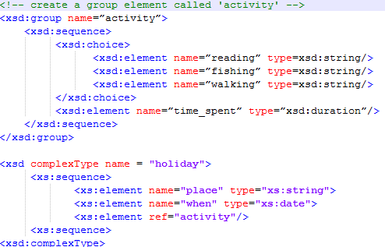
Complex Type - Grouping Elements

Slide 61
Controlling element occurrences
Occurrence constraints define the number of times a particular element can or must occur
Attributes:
minOccurs: Defines the minimum number of times an element can occur. Default value is 1
maxOccurs: Defines the maximum number of times an element can occur. Default value is 1
Can set the value of the “maxOccurs” attribute to “unbounded” to indicate that there is no maximum number of times the element can occur

Slide 62
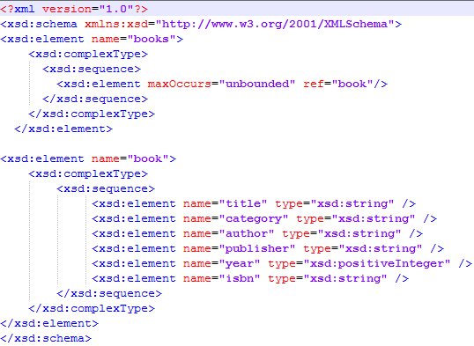
Book.xsd

Slide 63
Attaching .xsd file to xml
Add the following to xml document
<books xmlns:xsi = "http://www.w3.org/2001/XMLSchema-instance"
xsi:noNamespaceSchemaLocation="book.xsd">
Here books is the root element in the xml file

Slide 64
Shortcomings of CSS
Elements appear in same order in which they appear in XML document
Not a programming language
No relationships between siblings
Cannot automatically generate text

Slide 65
XSLT style sheet
Developed to provide means to transform and format the content of XML documents
Converts an XML document into something else
eg .html or .pdf or even another XML document
The namespace for XSLT is: http://www.w3.org/1999/XSL/Transform
XSLT is currently the most widely used XSL

Slide 66
XSLT style sheet
XSL processor analyses an XML document and breaks it into nodes
Each node represents a part of the document and is either;
an element
an attribute
some text
Nodes are organised a hierarchical (tree) representation of the entire document
Called the source tree

Slide 67
XSLT style sheet
When the XSL processor finishes building the node tree it will search an XSLT stylesheet for instructions on how to use the nodes
Node instructions are contained within templates in the XSLT style sheet

Slide 68
XSLT style sheet (simple.xsl, employee.xml)
XSLT style sheet is an XML document and as such must have a root element and an XML declaration
<?xml version=“1.0” encoding=“UTF-8” ?>
<xsl:stylesheet version=“1.0”
xmlns:xsl=http://www.w3c.org/1999/XSL/Transform >
<!-- style sheet rules here -->
</xsl:stylesheet>

Slide 69
outputting values
Use the empty element value-of together with the attribute select
<xsl:value-of select="."/>
This will return the value of the current node. Can also return the values of child, parent and sibling nodes

Slide 70
outputting values
<xsl:value-of select=".."/>
Returns parent
<xsl:value-of select=“blah”/>
Returns value of “blah” (assuming “blah” is a child of the current node)
<xsl:value-of select =“../sibling”/>
Returns value of “sibling” (assuming “sibling” is a sibling of the current node).

Slide 71
Root node
Often we’ll start processing at the root node
This can be found by using the pattern “/”
All other nodes can be reached from this node

Slide 72
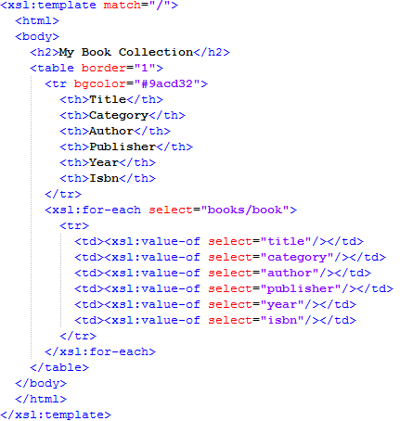
book.xslt

Slide 73
Attaching a xslt to xml file
Add the following line before the root element
<?xml-stylesheet type="text/xsl" href="book.xslt"?>

Slide 74
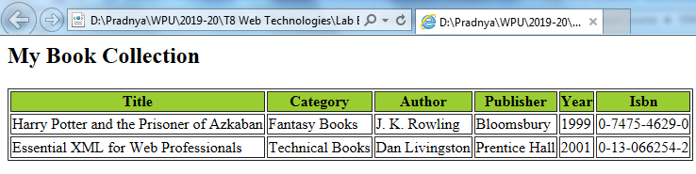
Opening book.xml in browser

Slide 75
References
https://www.tutorialspoint.com/dtd
https://www.w3schools.com/xml/xml_namespaces.asp
https://goldberg.berkeley.edu/courses/F04/215/XML-215-presentation.ppt

